Slide 1


Introduction to the Django Framework
By thomas werthenbach

Slide 2
Content
What is Django?
Why should you use it?
Example
Live coding

Slide 3
What is Django?
First of all… What is a web framework?

Slide 4
What is Django?
Incoming… some slides from the Department of Computer Science, University of Taipei…

Slide 5
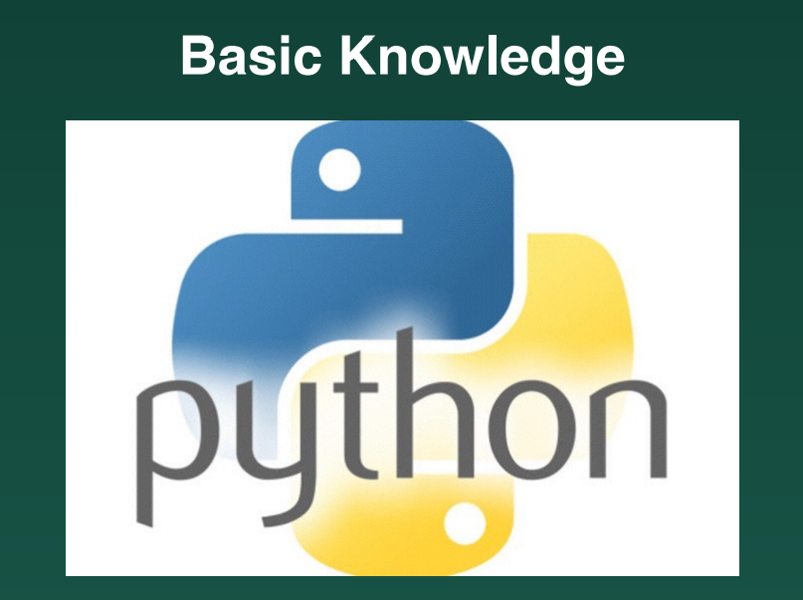

Slide 6
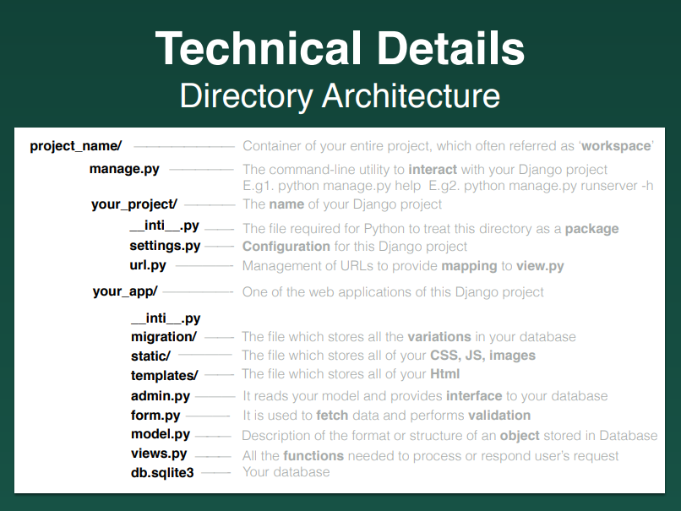

Slide 8
Let’s have a look at the configurations of such a Django project

Slide 9
Is this framework actually used?

Slide 10
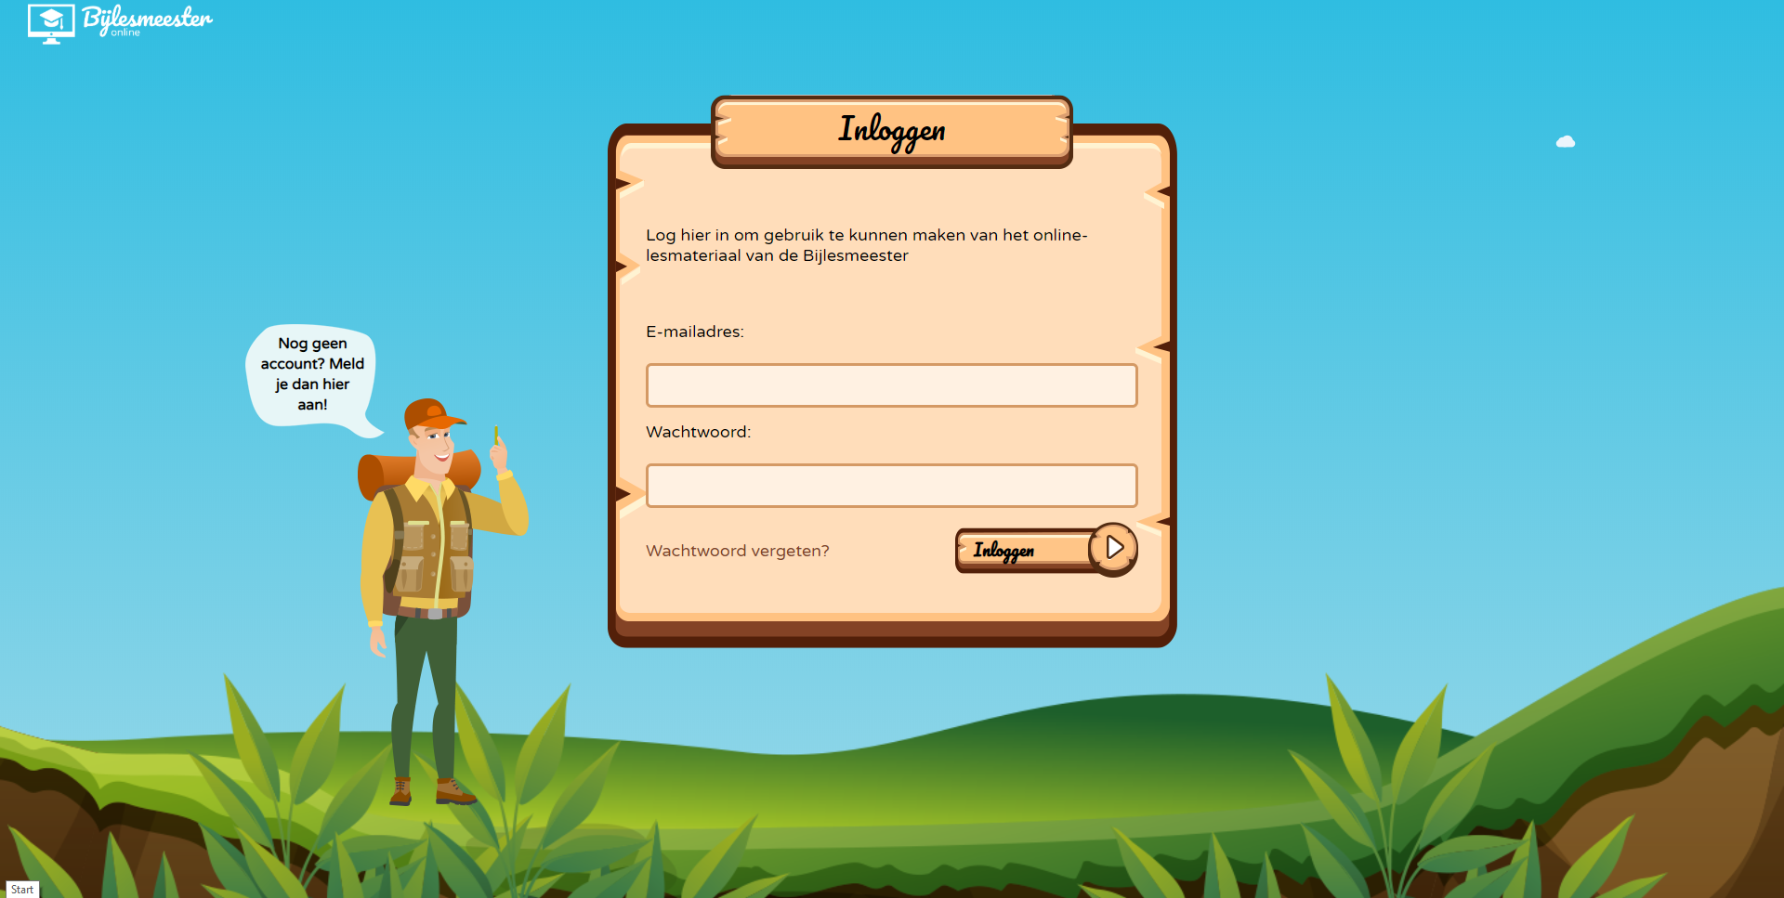
Example time!

Slide 11
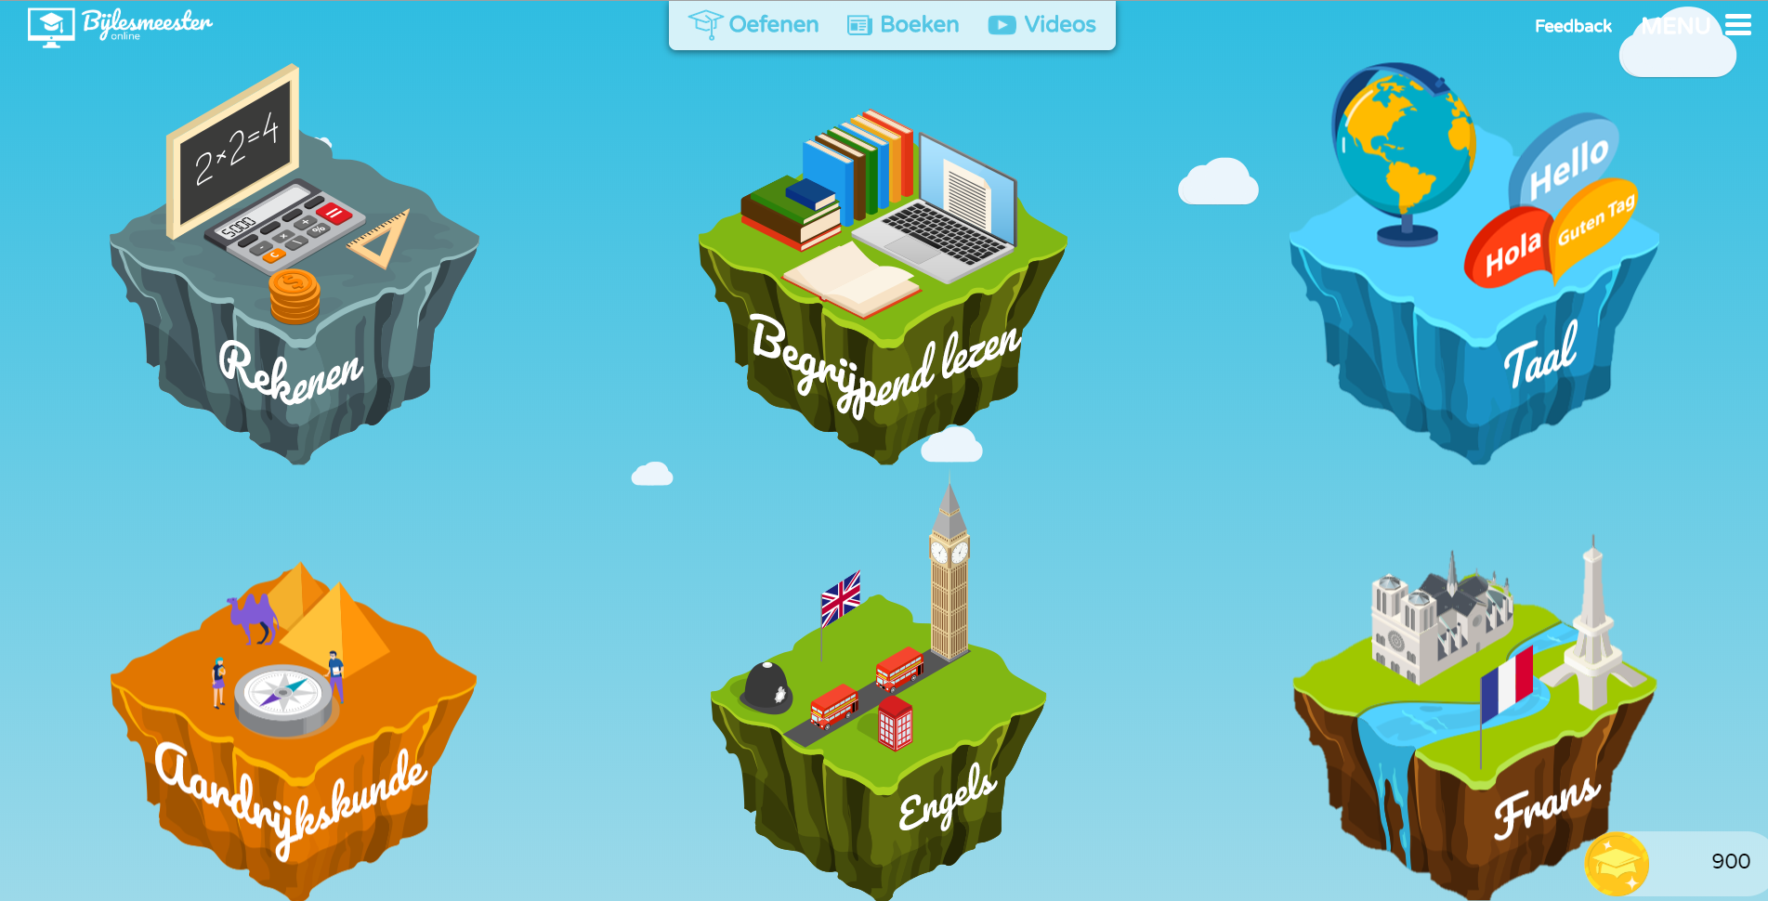
Example time!

Slide 12
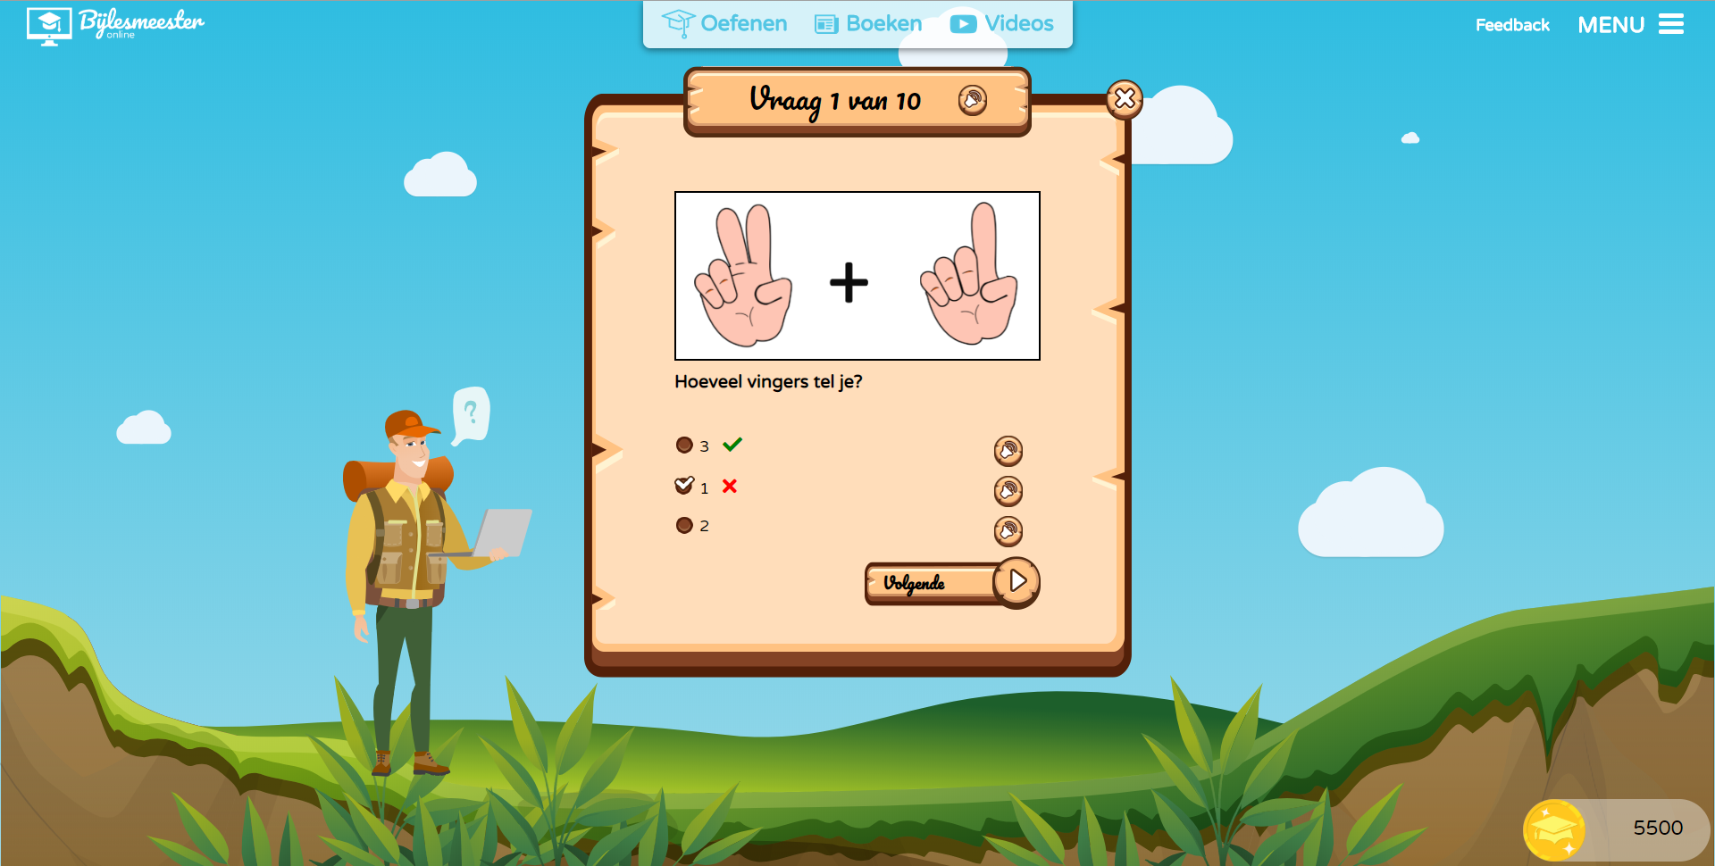
Example time!

Slide 13
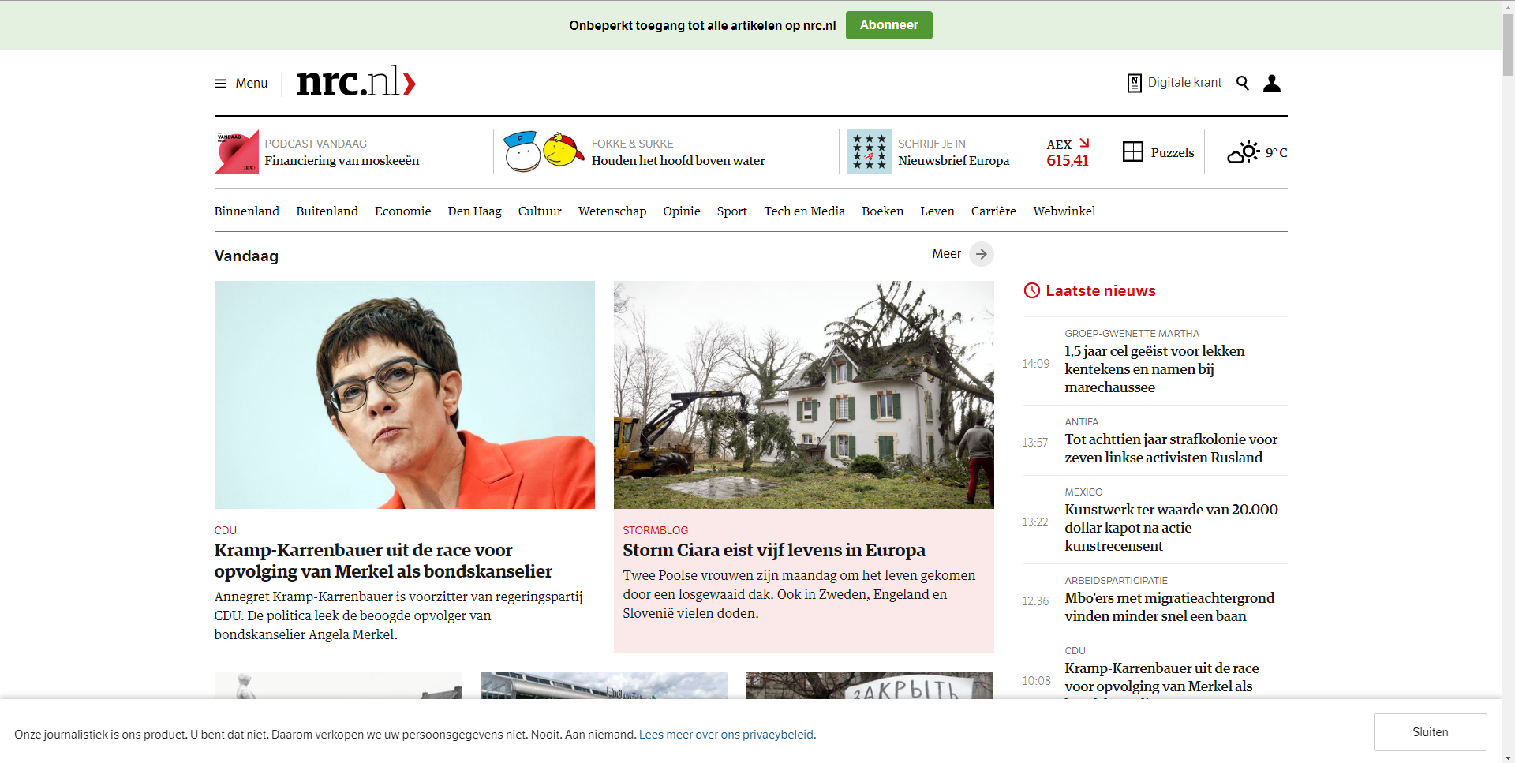
Example time!

Slide 14
Finally, done with the boring examples. Let’s do some coding!

Slide 15
Finally, done with the boring examples. Let’s do some coding!
What kind of website shall we create using this fancy framework?

Slide 16
Let’s create a webshop for peanutbutter!

Slide 17
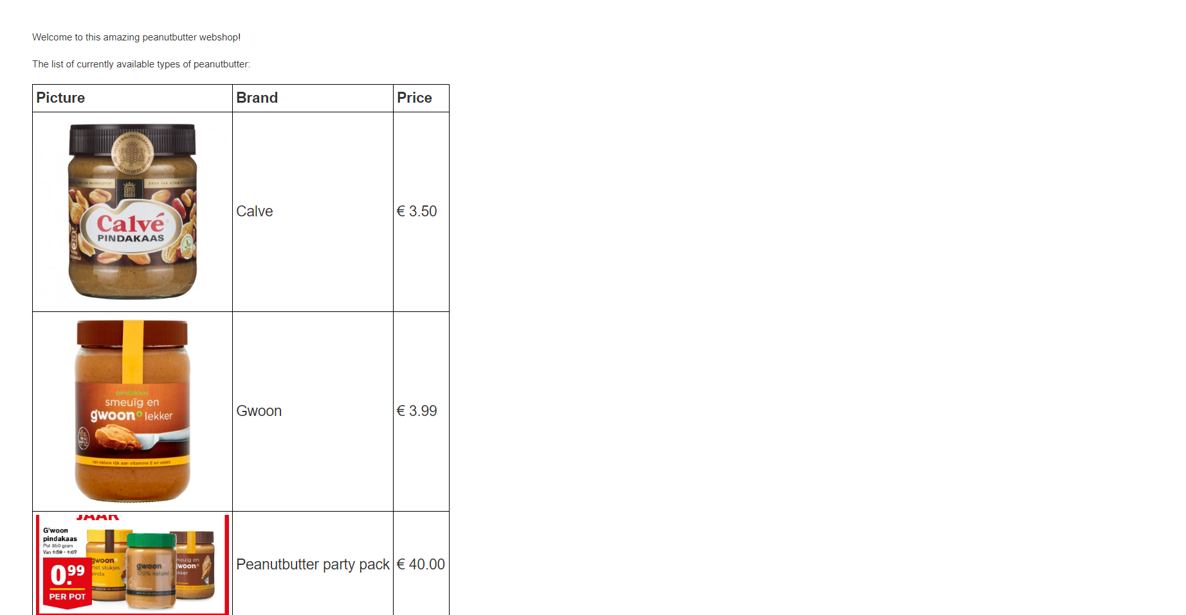
Let’s create a webshop for peanutbutter!

